Slide 1
Chapter 5 – More About Block Ciphers

Slide 2
Content of this Chapter
Encryption with Block Ciphers: Modes of Operation
Electronic Code Book mode (ECB)
Cipher Block Chaining mode (CBC)
Output Feedback mode (OFB)
Cipher Feedback mode (CFB)
Counter mode (CTR)
XTS-AES
Exhaustive Key Search Revisited
Increasing the Security of Block Ciphers

Slide 3
Block Ciphers
A block cipher is much more than just an encryption algorithm, it can be used ...
to build different types of block-based encryption schemes
to realize stream ciphers
to construct hash functions
to make message authentication codes
to build key establishment protocols
to make a pseudo-random number generator
...
The security of block ciphers also can be increased by
key whitening
multiple encryption

Slide 4
Content of this Chapter
Encryption with Block Ciphers: Modes of Operation
Electronic Code Book mode (ECB)
Cipher Block Chaining mode (CBC)
Output Feedback mode (OFB)
Cipher Feedback mode (CFB)
Counter mode (CTR)
XTS-AES
Exhaustive Key Search Revisited
Increasing the Security of Block Ciphers

Slide 5
Encryption with Block Ciphers
There are several ways of encrypting long plaintexts, e.g., an e-mail or a computer file, with a block cipher (“modes of operation”)
Electronic Code Book mode (ECB)
Cipher Block Chaining mode (CBC)
Output Feedback mode (OFB)
Cipher Feedback mode (CFB)
Counter mode (CTR)
XTS-AES
All of the 6 modes have one goal:
In addition to confidentiality, they provide authenticity and integrity:
Is the message really coming from the original sender? (authenticity)
Was the ciphertext altered during transmission? (integrity)

Slide 6
Content of this Chapter
Encryption with Block Ciphers: Modes of Operation
Electronic Code Book mode (ECB)
Cipher Block Chaining mode (CBC)
Output Feedback mode (OFB)
Cipher Feedback mode (CFB)
Counter mode (CTR)
XTS-AES
Exhaustive Key Search Revisited
Increasing the Security of Block Ciphers

Slide 7
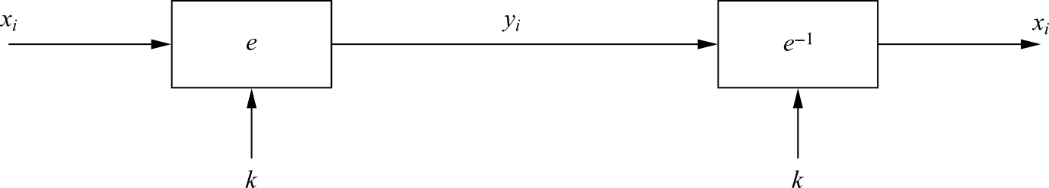
Electronic Code Book mode (ECB)
e_{k}(x_{i}) denote the encryption of a b-bit plaintext block x_{i} with key k
e_{k}⁻¹(y_{i}) denote the decryption of b-bit ciphertext block y_{i} with key k
Messages which exceed b bits are partitioned into b-bit blocks
Each Block is encrypted separately
Encryption: y_{i} = e_{k} (x_{i}), i ≥ 1
Decryption: x_{i} = e_{k}⁻¹ (y_{i}) = e_{k}⁻¹ (e_{k} (x_{i})), i ≥ 1

Slide 8
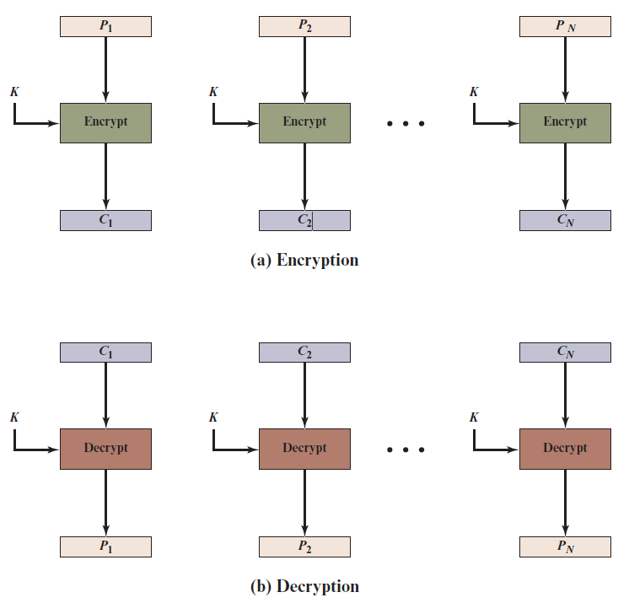
Electronic Codebook (E C B) Mode
Notes:
The simplest mode is the electronic codebook (ECB ) mode, in which plaintext
is handled one block at a time and each block of plaintext is encrypted using the
same key (Figure 7.3). The term codebook is used because, for a given key, there is
a unique ciphertext for every b -bit block of plaintext. Therefore, we can imagine a
gigantic codebook in which there is an entry for every possible b -bit plaintext pattern
showing its corresponding ciphertext.
For a message longer than b bits, the procedure is simply to break the message
into b -bit blocks, padding the last block if necessary. Decryption is performed one
block at a time, always using the same key. In Figure 7.3, the plaintext (padded as
necessary) consists of a sequence of b -bit blocks, P₁ , P₂ , . . . , P_{N} ; the corresponding
sequence of ciphertext blocks is C₁ , C₂ , . . . , C_{N} . We can define ECB mode as
follows.
ECB C_{j} = E(K, Pj) j = 1, . . . , N P_{j} = D(K, Cj₎ j = 1, . . . , N
The ECB mode should be used only to secure messages shorter than a single block of underlying cipher (i.e., 64 bits for 3DES and 128 bits for AES), such as to encrypt a secret key. Because in most of the cases messages are longer than the encryption block mode, this mode has a minimum practical value.
The most significant characteristic of ECB is that if the same b -bit block of
plaintext appears more than once in the message, it always produces the same
ciphertext.
For lengthy messages, the ECB mode may not be secure. If the message is
highly structured, it may be possible for a cryptanalyst to exploit these regularities.
For example, if it is known that the message always starts out with certain
predefined fields, then the cryptanalyst may have a number of known plaintext–
ciphertext pairs to work with. If the message has repetitive elements with a
period of repetition a multiple of b bits, then these elements can be identified by the
analyst. This may help in the analysis or may provide an opportunity for substituting
or rearranging blocks.

Slide 9
ECB: advantages/disadvantages
Advantages
no block synchronization between sender and receiver is required
bit errors caused by noisy channels only affect the corresponding block but not succeeding blocks
Block cipher operating can be parallelized
advantage for high-speed implementations
Disadvantages
ECB encrypts highly deterministically
identical plaintexts result in identical ciphertexts
an attacker recognizes if the same message has been sent twice
plaintext blocks are encrypted independently of previous blocks
an attacker may reorder ciphertext blocks which results in valid plaintext

Slide 10

Substitution Attack on ECB
Once a particular plaintext to ciphertext block mapping x_{i} → y_{i} is known, a sequence of ciphertext blocks can easily be manipulated
Suppose an electronic bank transfer
the encryption key between the two banks does not change too frequently
The attacker sends $1.00 transfers from his account at bank A to his account at bank B repeatedly
He can check for ciphertext blocks that repeat, and he stores blocks 1,3 and 4 of these transfers
He now simply replaces block 4 of other transfers with the block 4 that he stored before
all transfers from some account of bank A to some account of bank B are redirected to go into the attacker’s B account!

Slide 11



Example of encrypting bitmaps in ECB mode
Identical plaintexts are mapped to identical ciphertexts
Statistical properties in the plaintext are preserved in the ciphertext
Encrypted using ECB mode
Modes other than ECB result in pseudo-randomness

Slide 12
Content of this Chapter
Encryption with Block Ciphers: Modes of Operation
Electronic Code Book mode (ECB)
Cipher Block Chaining mode (CBC)
Output Feedback mode (OFB)
Cipher Feedback mode (CFB)
Counter mode (CTR)
XTS-AES
Exhaustive Key Search Revisited
Increasing the Security of Block Ciphers

Slide 13
Cipher Block Chaining mode (CBC)
There are two main ideas behind the CBC mode:
The encryption of all blocks are “chained together”
ciphertext y_{i} depends not only on block x_{i} but on all previous plaintext blocks as well
The encryption is randomized by using an initialization vector (IV)
Encryption (first block): y₁ = e_{k} (x₁ ⊕ IV)
Encryption (general block): y_{i} = e_{k} (x_{i} ⊕ y_{i−1}), i ≥ 2
Decryption (first block): x₁ = e_{k}⁻¹ (y₁) ⊕ IV
Decryption (general block) : x_{i} = e_{k}⁻¹ (y_{i}) ⊕ y_{i−1}, i ≥ 2

Slide 14
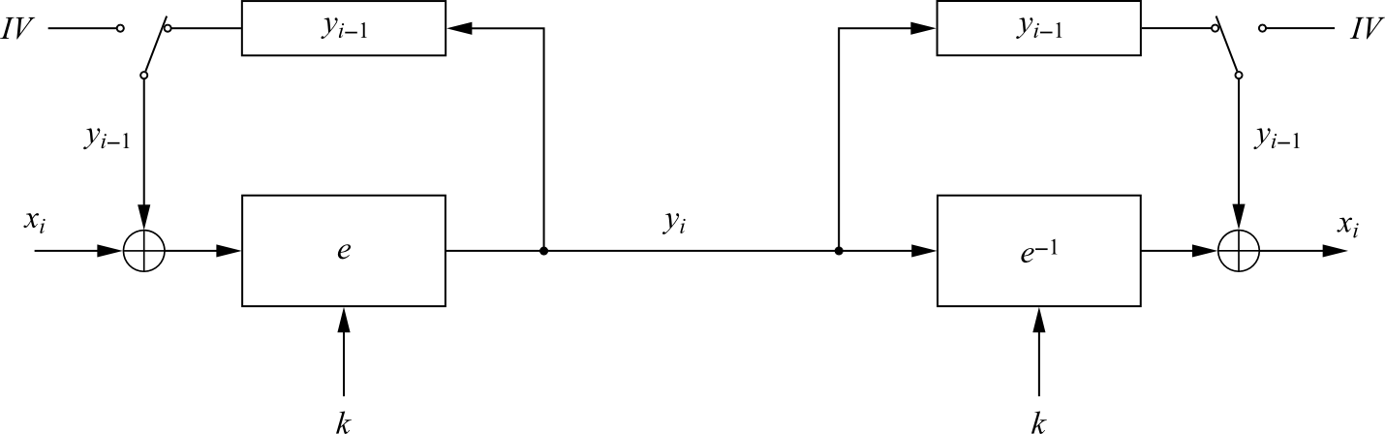
Cipher Block Chaining mode (CBC)
For the first plaintext block x₁ there is no previous ciphertext
an IV is added to the first plaintext to make each CBC encryption nondeterministic
the first ciphertext y₁ depends on plaintext x₁ and the IV
The second ciphertext y₂ depends on the IV, x₁ and x₂
The third ciphertext y₃ depends on the IV and x₁, x₂ and x₃, and so on

Slide 15
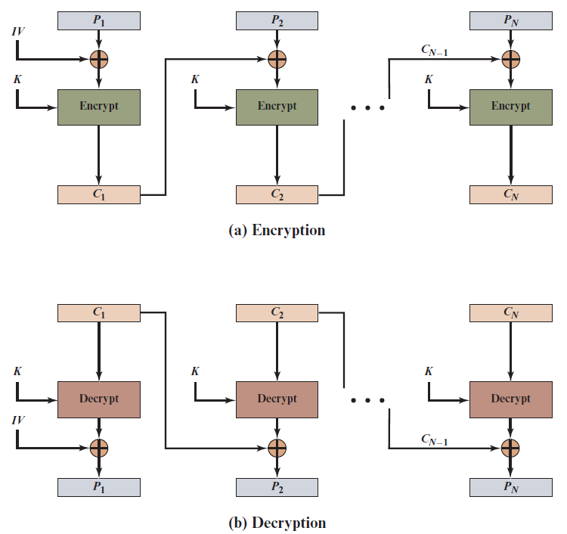
Cipher Block Chaining (C B C) Mode
Notes:
To overcome the security deficiencies of ECB, we would like a technique in which
the same plaintext block, if repeated, produces different ciphertext blocks. A
simple way to satisfy this requirement is the cipher block chaining (CBC ) mode
(Figure 7.4). In this scheme, the input to the encryption algorithm is the XOR of the
current plaintext block and the preceding ciphertext block; the same key is used for
each block. In effect, we have chained together the processing of the sequence of
plaintext blocks. The input to the encryption function for each plaintext block bears
no fixed relationship to the plaintext block. Therefore, repeating patterns of b bits
are not exposed. As with the ECB mode, the CBC mode requires that the last block
be padded to a full b bits if it is a partial block.
For decryption, each cipher block is passed through the decryption algorithm.
The result is XORed with the preceding ciphertext block to produce the plaintext
block.
To produce the first block of ciphertext, an initialization vector (IV) is XORed
with the first block of plaintext. On decryption, the IV is XORed with the output
of the decryption algorithm to recover the first block of plaintext. The IV is a data
block that is the same size as the cipher block.
The IV must be known to both the sender and receiver but be unpredictable
by a third party. In particular, for any given plaintext, it must not be possible to
predict the IV that will be associated to the plaintext in advance of the generation
of the IV. For maximum security, the IV should be protected against unauthorized
changes. This could be done by sending the IV using ECB encryption. One reason
for protecting the IV is as follows: If an opponent is able to fool the receiver into
using a different value for IV, then the opponent is able to invert selected bits in the
first block of plaintext.
So long as it is unpredictable, the specific choice of IV is unimportant.
SP800-38A recommends two possible methods: The first method is to apply the
encryption function, under the same key that is used for the encryption of the plaintext,
to a nonce . The nonce must be a data block that is unique to each execution of
the encryption operation. For example, the nonce may be a counter, a timestamp, or
a message number. The second method is to generate a random data block using a
random number generator.
In conclusion, because of the chaining mechanism of CBC, it is an appropriate
mode for encrypting messages of length greater than b bits.
In addition to its use to achieve confidentiality, the CBC mode can be used for
authentication. This use is described in Chapter 12.

Slide 16
Substitution Attack on CBC
Suppose the last example (electronic bank transfer)
If the IV is properly chosen for every wire transfer, the attack will not work at all
If the IV is kept the same for several transfers, the attacker would recognize the transfers from his account at bank A to back B
If we choose a new IV every time we encrypt, the CBC mode becomes a probabilistic encryption scheme, i.e., two encryptions of the same plaintext look entirely different
It is not needed to keep the IV secret!
Typically, the IV should be a non-secret nonce (value used only once)

Slide 17
Content of this Chapter
Encryption with Block Ciphers: Modes of Operation
Electronic Code Book mode (ECB)
Cipher Block Chaining mode (CBC)
Output Feedback mode (OFB)
Cipher Feedback mode (CFB)
Counter mode (CTR)
XTS-AES
Exhaustive Key Search Revisited
Increasing the Security of Block Ciphers

Slide 18
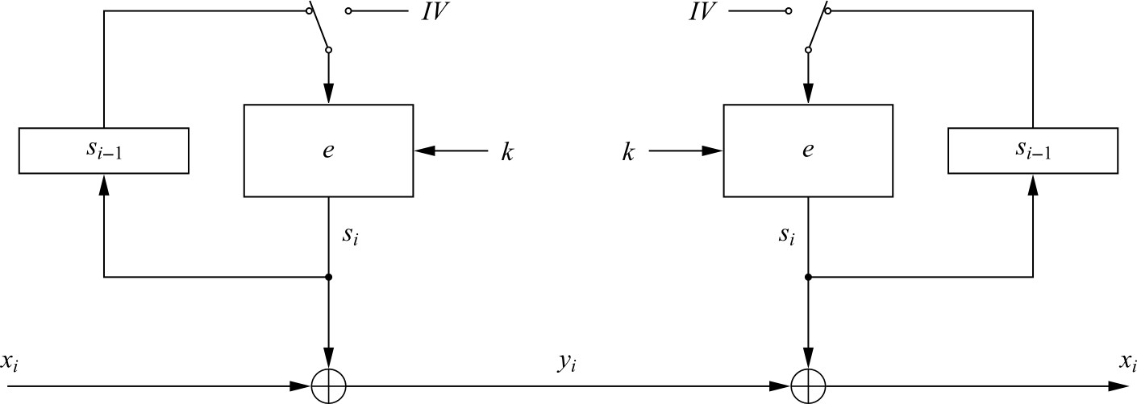
Output Feedback mode (OFB)
It is used to build a synchronous stream cipher from a block cipher
The key stream is not generated bitwise but instead in a blockwise fashion
The output of the cipher gives us key stream bits S_{i} with which we can encrypt plaintext bits using the XOR operation
Encryption (first block): s₁ = e_{k} (IV) and y₁ = s₁ ⊕ x₁
Encryption (general block): s_{i} = e_{k} (s_{i−1}) and y_{i} = s_{i} ⊕ x_{i} , i ≥ 2
Decryption (first block): s₁ = e_{k} (IV) and x₁ = s₁ ⊕ y₁
Decryption (general block) : s_{i} = e_{k} (s_{i−1}) and x_{i} = s_{i} ⊕ y_{i} , i ≥ 2

Slide 19
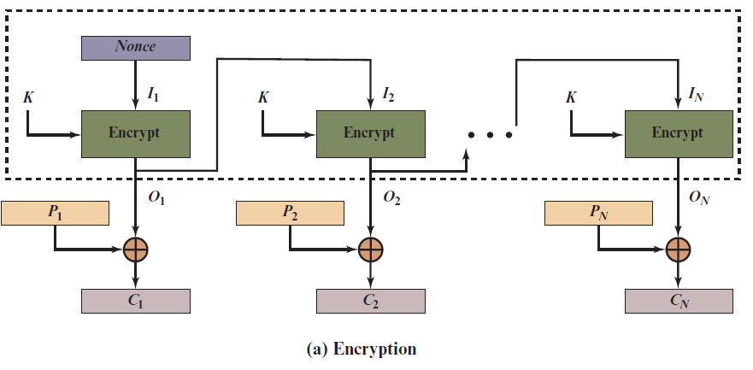
Output Feedback (O F B) Mode (1 of 2)
Notes:
The output feedback (OFB) mode is similar in structure to that of CFB. For OFB,
the output of the encryption function is fed back to become the input for encrypting
the next block of plaintext (Figure 7.6). In CFB, the output of the XOR unit is fed
back to become input for encrypting the next block. The other difference is that the
OFB mode operates on full blocks of plaintext and ciphertext, whereas CFB operates
on an s -bit subset.
As with CBC and CFB, the OFB mode requires an initialization vector. In
the case of OFB, the IV must be a nonce; that is, the IV must be unique to each
execution of the encryption operation. The reason for this is that the sequence of
encryption output blocks, O_{i} , depends only on the key and the IV and does not depend
on the plaintext. Therefore, for a given key and IV, the stream of output bits
used to XOR with the stream of plaintext bits is fixed. If two different messages had
an identical block of plaintext in the identical position, then an attacker would be
able to determine that portion of the O_{i} stream.
One advantage of the OFB method is that bit errors in transmission do not
propagate. For example, if a bit error occurs in C₁ , only the recovered value of P₁ is
affected; subsequent plaintext units are not corrupted. With CFB, C₁ also serves as
input to the shift register and therefore causes additional corruption downstream.
The disadvantage of OFB is that it is more vulnerable to a message stream
modification attack than is CFB. Consider that complementing a bit in the ciphertext
complements the corresponding bit in the recovered plaintext. Thus, controlled
changes to the recovered plaintext can be made. This may make it possible for an
opponent, by making the necessary changes to the checksum portion of the message
as well as to the data portion, to alter the ciphertext in such a way that it is not detected
by an error-correcting code. For a further discussion, see [VOYD83].
OFB has the structure of a typical stream cipher, because the cipher generates
a stream of bits as a function of an initial value and a key, and that stream of
bits is XORed with the plaintext bits (see Figure 4.1). The generated stream that is
XORed with the plaintext is itself independent of the plaintext; this is highlighted
by dashed boxes in Figure 7.6. One distinction from the stream ciphers we discuss
in Chapter 8 is that OFB encrypts plaintext a full block at a time, where typically a
block is 64 or 128 bits. Many stream ciphers encrypt one byte at a time.

Slide 20
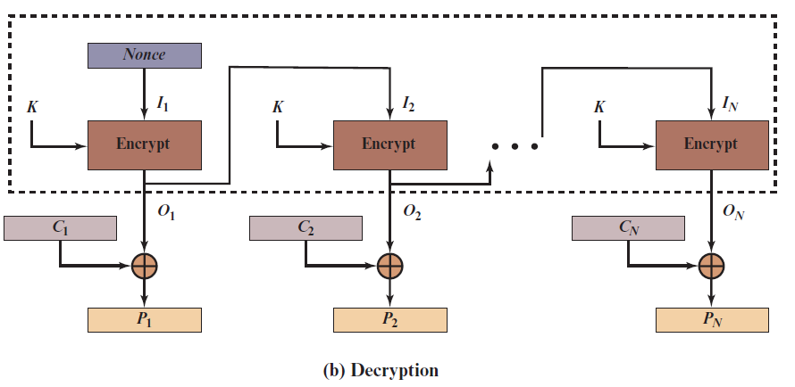
Output Feedback (O F B) Mode (2 of 2)
Notes:
The output feedback (OFB) mode is similar in structure to that of CFB. For OFB,
the output of the encryption function is fed back to become the input for encrypting
the next block of plaintext (Figure 7.6). In CFB, the output of the XOR unit is fed
back to become input for encrypting the next block. The other difference is that the
OFB mode operates on full blocks of plaintext and ciphertext, whereas CFB operates
on an s -bit subset.
As with CBC and CFB, the OFB mode requires an initialization vector. In
the case of OFB, the IV must be a nonce; that is, the IV must be unique to each
execution of the encryption operation. The reason for this is that the sequence of
encryption output blocks, O_{i} , depends only on the key and the IV and does not depend
on the plaintext. Therefore, for a given key and IV, the stream of output bits
used to XOR with the stream of plaintext bits is fixed. If two different messages had
an identical block of plaintext in the identical position, then an attacker would be
able to determine that portion of the O_{i} stream.
One advantage of the OFB method is that bit errors in transmission do not
propagate. For example, if a bit error occurs in C₁ , only the recovered value of P₁ is
affected; subsequent plaintext units are not corrupted. With CFB, C₁ also serves as
input to the shift register and therefore causes additional corruption downstream.
The disadvantage of OFB is that it is more vulnerable to a message stream
modification attack than is CFB. Consider that complementing a bit in the ciphertext
complements the corresponding bit in the recovered plaintext. Thus, controlled
changes to the recovered plaintext can be made. This may make it possible for an
opponent, by making the necessary changes to the checksum portion of the message
as well as to the data portion, to alter the ciphertext in such a way that it is not detected
by an error-correcting code. For a further discussion, see [VOYD83].
OFB has the structure of a typical stream cipher, because the cipher generates
a stream of bits as a function of an initial value and a key, and that stream of
bits is XORed with the plaintext bits (see Figure 4.1). The generated stream that is
XORed with the plaintext is itself independent of the plaintext; this is highlighted
by dashed boxes in Figure 7.6. One distinction from the stream ciphers we discuss
in Chapter 8 is that OFB encrypts plaintext a full block at a time, where typically a
block is 64 or 128 bits. Many stream ciphers encrypt one byte at a time.

Slide 21
Content of this Chapter
Encryption with Block Ciphers: Modes of Operation
Electronic Code Book mode (ECB)
Cipher Block Chaining mode (CBC)
Output Feedback mode (OFB)
Cipher Feedback mode (CFB)
Counter mode (CTR)
XTS-AES
Exhaustive Key Search Revisited
Increasing the Security of Block Ciphers

Slide 22
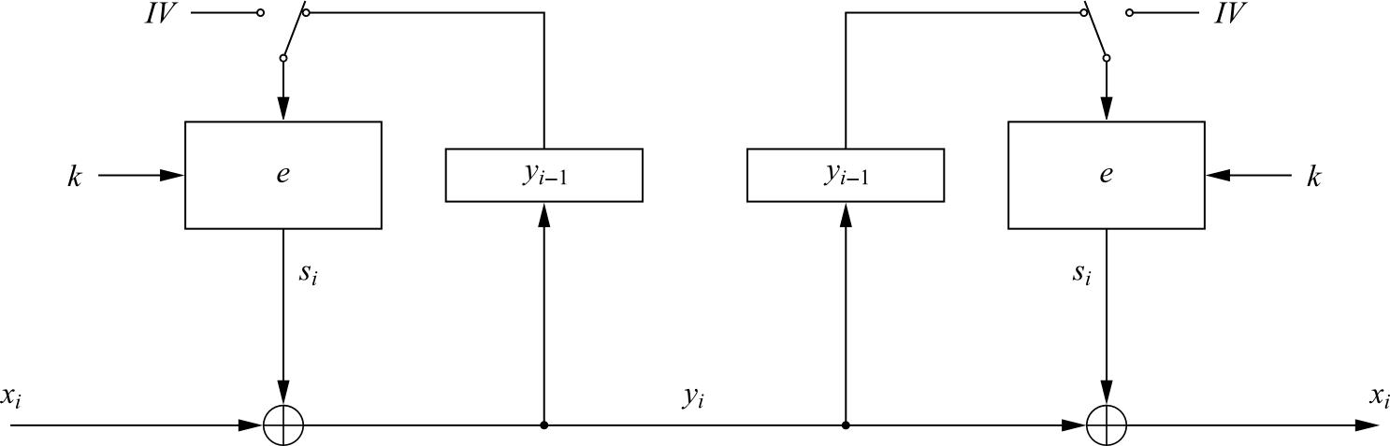
Cipher Feedback mode (CFB)
It uses a block cipher as a building block for an asynchronous stream cipher (similar to the OFB mode), more accurate name: “Ciphertext Feedback Mode”
The key stream S_{i} is generated in a blockwise fashion and is also a function of the ciphertext
As a result of the use of an IV, the CFB encryption is also nondeterministic
It can be used in situations where short plaintext blocks are to be encrypted
Encryption (first block): y₁ = e_{k} (IV) ⊕ x₁
Encryption (general block): y_{i} = e_{k} (y_{i−1}) ⊕ x_{i} , i ≥ 2
Decryption (first block): x₁ = e_{k} (IV) ⊕ y₁
Decryption (general block) : x_{i} = e_{k} (y_{i−1}) ⊕ y_{i} , i ≥ 2

Slide 23
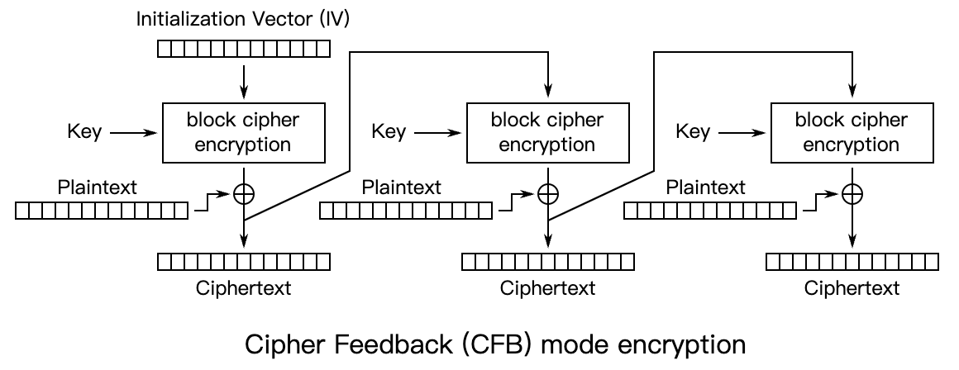
Cipher Feedback (C F B) Mode (1 of 2)
Notes:
Figure 7.5 depicts the CFB scheme. In the figure, it is assumed that the unit of
transmission is s bits; a common value is s = 8. As with CBC, the units of plaintext
are chained together, so that the ciphertext of any plaintext unit is a function of all
the preceding plaintext. In this case, rather than blocks of b bits, the plaintext is
divided into segments of s bits.
First, consider encryption. The input to the encryption function is a b -bit shift
register that is initially set to some initialization vector (IV). The leftmost (most
significant) s bits of the output of the encryption function are XORed with the
first segment of plaintext P₁ to produce the first unit of ciphertext C₁ , which is then
transmitted. In addition, the contents of the shift register are shifted left by s bits,
and C₁ is placed in the rightmost (least significant) s bits of the shift register. This
process continues until all plaintext units have been encrypted.
For decryption, the same scheme is used, except that the received ciphertext
unit is XORed with the output of the encryption function to produce the plaintext
unit. Note that it is the encryption function that is used, not the decryption function.
Although CFB can be viewed as a stream cipher, it does not conform to the
typical construction of a stream cipher. In a typical stream cipher, the cipher takes
as input some initial value and a key and generates a stream of bits, which is then
XORed with the plaintext bits (see Figure 4.1). In the case of CFB, the stream of
bits that is XORed with the plaintext also depends on the plaintext.
In CFB encryption, like CBC encryption, the input block to each forward
Cipher function (except the first) depends on the result of the previous forward
Cipher function; therefore, multiple forward cipher operations cannot be performed
in parallel. In CFB decryption, the required forward cipher operations can be performed
in parallel if the input blocks are first constructed (in series) from the IV and
the ciphertext.

Slide 24
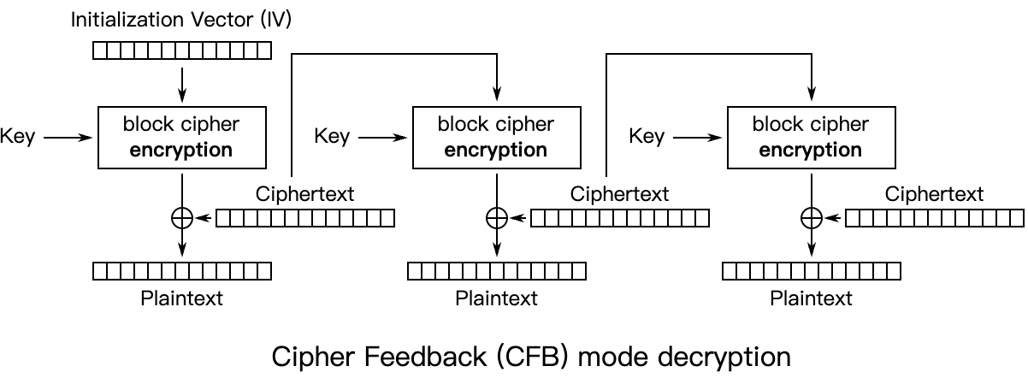
Cipher Feedback (C F B) Mode (2 of 2)
Notes:
Figure 7.5 depicts the CFB scheme. In the figure, it is assumed that the unit of
transmission is s bits; a common value is s = 8. As with CBC, the units of plaintext
are chained together, so that the ciphertext of any plaintext unit is a function of all
the preceding plaintext. In this case, rather than blocks of b bits, the plaintext is
divided into segments of s bits.
First, consider encryption. The input to the encryption function is a b -bit shift
register that is initially set to some initialization vector (IV). The leftmost (most
significant) s bits of the output of the encryption function are XORed with the
first segment of plaintext P₁ to produce the first unit of ciphertext C₁ , which is then
transmitted. In addition, the contents of the shift register are shifted left by s bits,
and C₁ is placed in the rightmost (least significant) s bits of the shift register. This
process continues until all plaintext units have been encrypted.
For decryption, the same scheme is used, except that the received ciphertext
unit is XORed with the output of the encryption function to produce the plaintext
unit. Note that it is the encryption function that is used, not the decryption function.
Although CFB can be viewed as a stream cipher, it does not conform to the
typical construction of a stream cipher. In a typical stream cipher, the cipher takes
as input some initial value and a key and generates a stream of bits, which is then
XORed with the plaintext bits (see Figure 4.1). In the case of CFB, the stream of
bits that is XORed with the plaintext also depends on the plaintext.
In CFB encryption, like CBC encryption, the input block to each forward
Cipher function (except the first) depends on the result of the previous forward
Cipher function; therefore, multiple forward cipher operations cannot be performed
in parallel. In CFB decryption, the required forward cipher operations can be performed
in parallel if the input blocks are first constructed (in series) from the IV and
the ciphertext.

Slide 25
Content of this Chapter
Encryption with Block Ciphers: Modes of Operation
Electronic Code Book mode (ECB)
Cipher Block Chaining mode (CBC)
Output Feedback mode (OFB)
Cipher Feedback mode (CFB)
Counter mode (CTR)
XTS-AES
Exhaustive Key Search Revisited
Increasing the Security of Block Ciphers

Slide 26
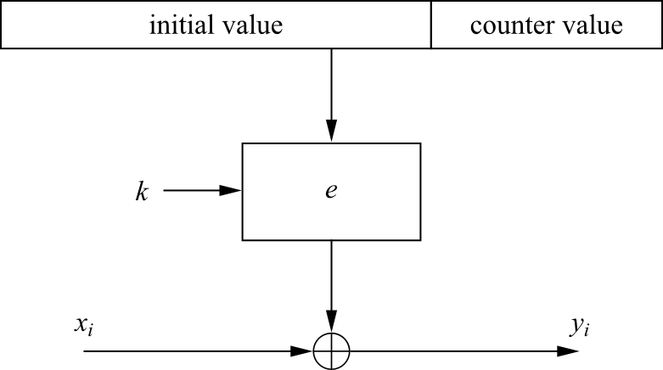
Counter mode (CTR)
It uses a block cipher as a stream cipher (like the OFB and CFB modes)
The key stream is computed in a blockwise fashion
The input to the block cipher is a counter which assumes a different value every time the block cipher computes a new key stream block
Unlike CFB and OFB modes, the CTR mode can be parallelized since the 2nd encryption can begin before the 1st one has finished
Desirable for high-speed implementations, e.g., in network routers
Encryption: y_{i} = e_{k} (IV || CTR_{i} ) ⊕ x_{i}, i ≥ 1
Decryption : x_{i} = e_{k} (IV || CTR_{i} ) ⊕ y_{i}, i ≥ 1

Slide 27
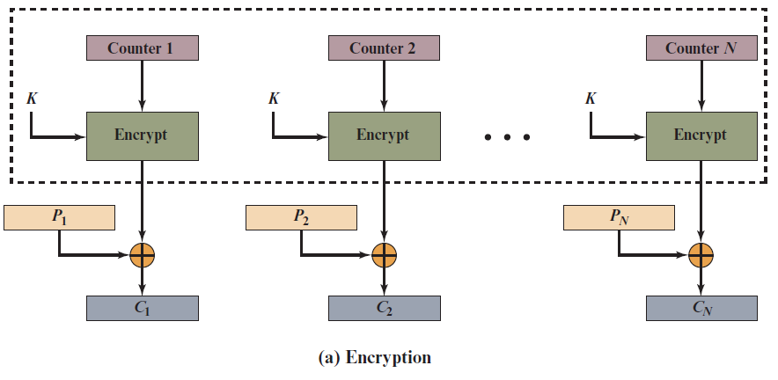
Counter (C T R) Mode (1 of 2)
Notes:
Although interest in the counter (CTR) mode has increased recently with applications
to ATM (asynchronous transfer mode) network security and IP sec (IP security),
this mode was proposed in 1979 (e.g., [DIFF79]).
Figure 7.7 depicts the CTR mode. A counter equal to the plaintext block
size is used. The only requirement stated in SP 800-38A is that the counter value
must be different for each plaintext block that is encrypted. Typically, the counter
is initialized to some value and then incremented by 1 for each subsequent block
(modulo 2^{b} , where b is the block size). For encryption, the counter is encrypted and
then XORed with the plaintext block to produce the ciphertext block; there is no
chaining. For decryption, the same sequence of counter values is used, with each encrypted
counter XORed with a ciphertext block to recover the corresponding plaintext
block. Thus, the initial counter value must be made available for decryption.
As with the OFB mode, the initial counter value must be a nonce; that is, T₁
must be different for all of the messages encrypted using the same key. Further,
all T_{i} values across all messages must be unique. If, contrary to this requirement, a
counter value is used multiple times, then the confidentiality of all of the plaintext
blocks corresponding to that counter value may be compromised. In particular, if
any plaintext block that is encrypted using a given counter value is known, then
the output of the encryption function can be determined easily from the associated
ciphertext block. This output allows any other plaintext blocks that are encrypted
using the same counter value to be easily recovered from their associated ciphertext
blocks.
One way to ensure the uniqueness of counter values is to continue to increment
the counter value by 1 across messages. That is, the first counter value of the
each message is one more than the last counter value of the preceding message.

Slide 28
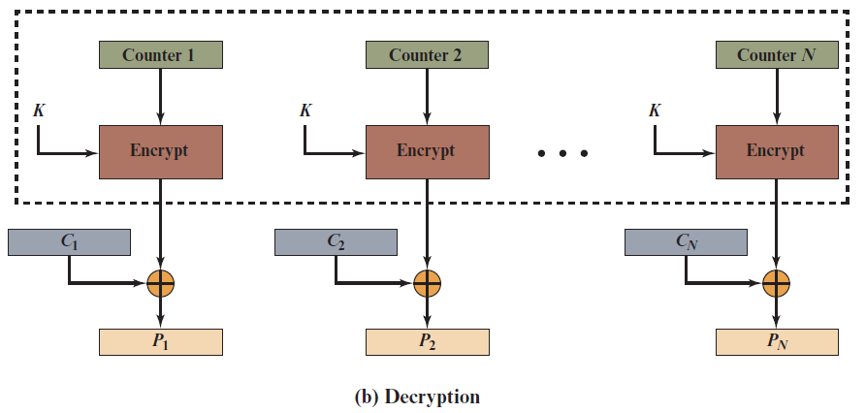
Counter (C T R) Mode (2 of 2)
Notes:
Although interest in the counter (CTR) mode has increased recently with applications
to ATM (asynchronous transfer mode) network security and IP sec (IP security),
this mode was proposed in 1979 (e.g., [DIFF79]).
Figure 7.7 depicts the CTR mode. A counter equal to the plaintext block
size is used. The only requirement stated in SP 800-38A is that the counter value
must be different for each plaintext block that is encrypted. Typically, the counter
is initialized to some value and then incremented by 1 for each subsequent block
(modulo 2^{b} , where b is the block size). For encryption, the counter is encrypted and
then XORed with the plaintext block to produce the ciphertext block; there is no
chaining. For decryption, the same sequence of counter values is used, with each encrypted
counter XORed with a ciphertext block to recover the corresponding plaintext
block. Thus, the initial counter value must be made available for decryption.
As with the OFB mode, the initial counter value must be a nonce; that is, T₁
must be different for all of the messages encrypted using the same key. Further,
all T_{i} values across all messages must be unique. If, contrary to this requirement, a
counter value is used multiple times, then the confidentiality of all of the plaintext
blocks corresponding to that counter value may be compromised. In particular, if
any plaintext block that is encrypted using a given counter value is known, then
the output of the encryption function can be determined easily from the associated
ciphertext block. This output allows any other plaintext blocks that are encrypted
using the same counter value to be easily recovered from their associated ciphertext
blocks.
One way to ensure the uniqueness of counter values is to continue to increment
the counter value by 1 across messages. That is, the first counter value of the
each message is one more than the last counter value of the preceding message.

Slide 29
Content of this Chapter
Encryption with Block Ciphers: Modes of Operation
Electronic Code Book mode (ECB)
Cipher Block Chaining mode (CBC)
Output Feedback mode (OFB)
Cipher Feedback mode (CFB)
Counter mode (CTR)
XTS-AES
Exhaustive Key Search Revisited
Increasing the Security of Block Ciphers

Slide 30
X T S-A E S Mode for Block-Oriented Storage Devices
Approved as an additional block cipher mode of operation by N I S T in 2010
Mode is also an I E E E Standard, I E E E Std 1619-2007
Standard describes a method of encryption for data stored in sector-based devices where the threat model includes possible access to stored data by the adversary
Has received widespread industry support
Notes:
In 2010, NIST approved an additional block cipher mode of operation, XTS-AES.
This mode is also an IEEE standard, IEEE Std 1619-2007, which was developed
by the IEEE Security in Storage Working Group (P1619). The standard describes
a method of encryption for data stored in sector-based devices where the threat
model includes possible access to stored data by the adversary. The standard has
received widespread industry support.

Slide 31
Tweakable Block Ciphers
X T S-A E S mode is based on the concept of a tweakable block cipher
General structure:
Has three inputs:
A plaintext P
A symmetric key K
A tweak T
Produces a ciphertext output C
Tweak need not be kept secret
Purpose is to provide variability
Notes:
The XTS-AES mode is based on the concept of a tweakable block cipher, introduced
in [LISK02], The form of this concept used in XTS-AES was first described in [ROGA04].
Before examining XTS-AES, let us consider the general structure of a tweakable
block cipher. A tweakable block cipher is one that has three inputs: a plaintext P ,
a symmetric key K , and a tweak T ; and produces a ciphertext output C . We can
write this as C = E(K , T , P ). The tweak need not be kept secret. Whereas the purpose
of the key is to provide security, the purpose of the tweak is to provide variability.
That is, the use of different tweaks with the same plaintext and same key
produces different outputs.

Slide 32
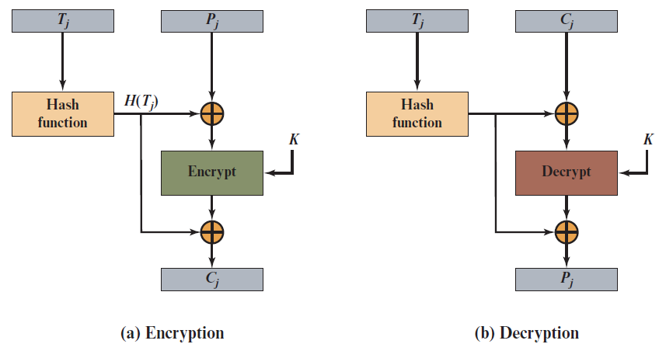
Figure 7.9 Tweakable Block Cipher
Notes:
The basic structure of several tweakable clock ciphers
that have been implemented is shown in Figure 7.9.

Slide 33
Storage Encryption Requirements
The requirements for encrypting stored data, also referred to as “data at rest”, differ somewhat from those for transmitted data
The P1619 standard was designed to have the following characteristics:
The ciphertext is freely available for an attacker
The data layout is not changed on the storage medium and in transit
Data are accessed in fixed sized blocks, independently from each other
Encryption is performed in 16-byte blocks, independently from each other
There are no other metadata used, except the location of the data blocks within the whole data set
The same plaintext is encrypted to different ciphertexts at different locations, but always to the same ciphertext when written to the same location again
A standard conformant device can be constructed for decryption of data encrypted by another standard conformant device
Notes:
The requirements for encrypting stored data, also referred to as “data at rest” differ
somewhat from those for transmitted data. The P1619 standard was designed to
have the following characteristics:
1. The ciphertext is freely available for an attacker. Among the circumstances
that lead to this situation:
a. A group of users has authorized access to a database. Some of the records in
the database are encrypted so that only specific users can successfully read/
write them. Other users can retrieve an encrypted record but are unable to
read it without the key.
b. An unauthorized user manages to gain access to encrypted records.
c. A data disk or laptop is stolen, giving the adversary access to the encrypted
data.
2. The data layout is not changed on the storage medium and in transit. The encrypted
data must be the same size as the plaintext data.
3. Data are accessed in fixed sized blocks, independently from each other. That is,
an authorized user may access one or more blocks in any order.
4. Encryption is performed in 16-byte blocks, independently from other blocks
(except the last two plaintext blocks of a sector, if its size is not a multiple of
16 bytes).
5. There are no other metadata used, except the location of the data blocks
within the whole data set.
6. The same plaintext is encrypted to different ciphertexts at different locations,
but always to the same ciphertext when written to the same location again.
7. A standard conformant device can be constructed for decryption of data encrypted
by another standard conformant device.
The P1619 group considered some of the existing modes of operation for use with
stored data. For CTR mode, an adversary with write access to the encrypted media can
flip any bit of the plaintext simply by flipping the corresponding ciphertext bit.
Next, consider requirement 6 and the use of CBC. To enforce the requirement
that the same plaintext encrypts to different ciphertext in different locations, the IV
could be derived from the sector number. Each sector contains multiple blocks. An
adversary with read/write access to the encrypted disk can copy a ciphertext sector
from one position to another, and an application reading the sector off the new
location will still get the same plaintext sector (except perhaps the first 128 bits).
For example, this means that an adversary that is allowed to read a sector from the
second position but not the first can find the content of the sector in the first position
by manipulating the ciphertext. Another weakness is that an adversary can flip
any bit of the plaintext by flipping the corresponding ciphertext bit of the previous
block, with the side-effect of “randomizing” the previous block.

Slide 34
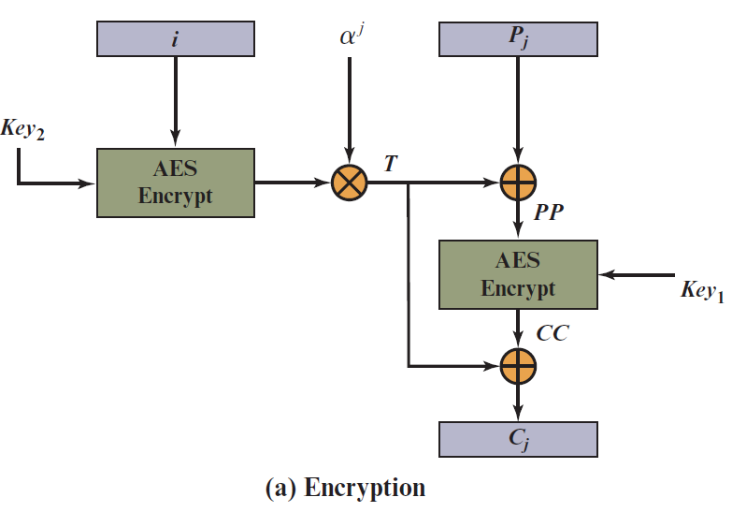
X T S-A E S Operation on Single Block
Figure 7.10 X T S-A E S Operation on Single Block
Notes:
Figure 7.10 shows the encryption and decryption of a single block. The operation involves
two instances of the AES algorithm with two keys.

Slide 35
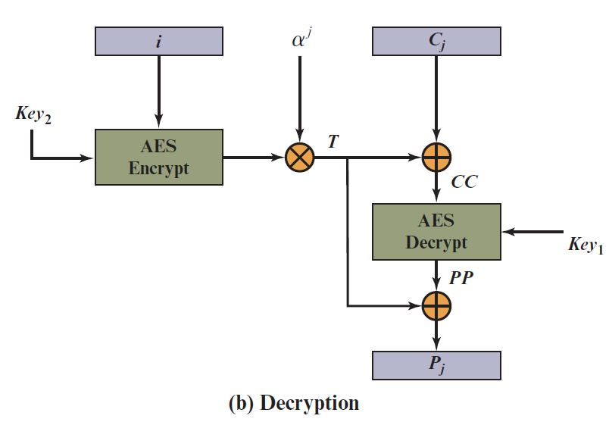
X T S-A E S Operation on Single Block
Figure 7.10 X T S-A E S Operation on Single Block
Notes:
Figure 7.10 shows the encryption and decryption of a single block. The operation involves
two instances of the AES algorithm with two keys.

Slide 36
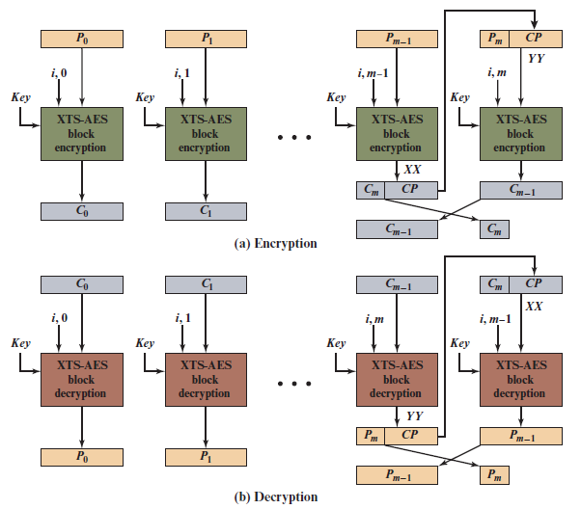
Figure 7.11 X T S-A E S Mode
Notes:
The plaintext of a sector or data unit is organized into blocks of 128 bits. Blocks are
labeled P₀ , P₁ , . . . , P_{m} . The last block my be null or may contain from 1 to 127 bits.
In other words, the input to the XTS-AES algorithm consists of m 128-bit blocks
and possibly a final partial block.
As can be seen, XTS-AES mode, like CTR mode, is suitable for parallel operation. Because there is no chaining, multiple blocks can be encrypted or decrypted simultaneously. Unlike CTR mode, XTS-AES mode includes a nonce (the parameter i) as well as a counter (parameter j).
For encryption and decryption, each block is treated independently and
encrypted/decrypted as shown in Figure 7.10. The only exception occurs when
the last block has less than 128 bits. In that case, the last two blocks are encrypted/
decrypted using a ciphertext-stealing technique instead of padding.
Figure 7.11 shows the scheme.

Slide 37
Content of this Chapter
Encryption with Block Ciphers: Modes of Operation
Exhaustive Key Search Revisited
Increasing the Security of Block Ciphers

Slide 38
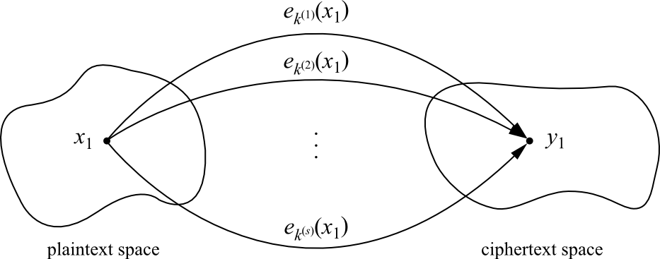
Exhaustive Key Search Revisited
A simple exhaustive search for a DES key knowing one pair (x₁,y₁):
DES_{k}^{(i)} (x₁) y₁, i = 0,1, . . . ,2⁵⁶−1
However, for most other block ciphers a key search is somewhat more complicated
A brute-force attack can produce false positive results
keys k_{i} that are found are not the one used for the encryption
The likelihood of this is related to the relative size of the key space and the plaintext space
A brute-force attack is still possible, but several pairs of plaintext–ciphertext are needed
?
=

Slide 39
An Exhaustive Key Search Example
Assume a cipher with a block width of 64 bit and a key size of 80 bit
If we encrypt x₁ under all possible 2⁸⁰ keys, we obtain 2⁸⁰ ciphertexts
However, there exist only 2⁶⁴ different ones
If we run through all keys for a given plaintext–ciphertext pair, we find on average 2⁸⁰/2⁶⁴ = 2¹⁶ keys that perform the mapping e_{k}(x₁) = y₁
In this example assuming two plaintext-ciphertext pairs, the likelihood is
2^{80−2·64}=2 ⁻⁴⁸
for almost all practical purposes two plaintext-ciphertext pairs are sufficient
Given a block cipher with a key length of k bits and block size of n bits, as well as t plaintext–ciphertext pairs (x₁, y₁), ... , (x_{t} , y_{t}), the expected number of false keys which encrypt all plaintexts to the corresponding ciphertexts is:
2^{k−tn}

Slide 40
Content of this Chapter
Encryption with Block Ciphers: Modes of Operation
Exhaustive Key Search Revisited
Increasing the Security of Block Ciphers
Double Encryption and Meet-in-the-Middle Attack
Triple Encryption
Key Whitening

Slide 41
Increasing the Security of Block Ciphers
In some situations we wish to increase the security of block ciphers, e.g., if a cipher such as DES is available in hardware or software for legacy reasons in a given application
Two approaches are possible
Multiple encryption
theoretically much more secure, but sometimes in practice increases the security very little
Key whitening

Slide 42
Content of this Chapter
Encryption with Block Ciphers: Modes of Operation
Exhaustive Key Search Revisited
Increasing the Security of Block Ciphers
Double Encryption and Meet-in-the-Middle Attack
Triple Encryption
Key Whitening

Slide 43
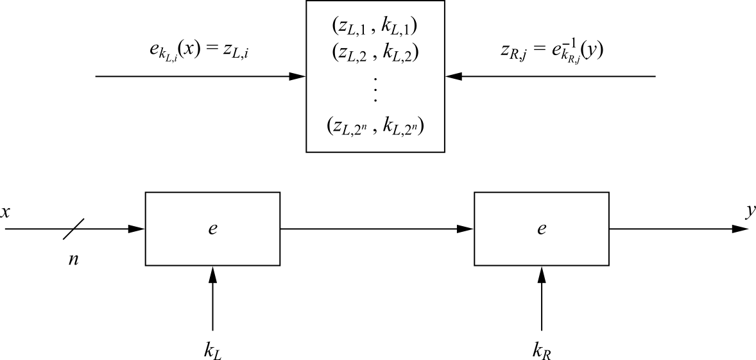
Double Encryption
A plaintext x is first encrypted with a key k_{L}, and the resulting ciphertext is encrypted again using a second key k_{R}
Assuming a key length of k bits, an exhaustive key search would require 2^{k}·2^{k} = 2^{2k} encryptions or decryptions

Slide 44
Meet-in-the-Middle Attack
A Meet-in-the-Middle attack requires 2^{k}+2^{k} = 2^{k+1} operations!
Phase I: for the given (x₁, y₁) the left encryption is brute-forced for all k_{L,i}, i=1,2, ..., 2^{k} and a lookup table with 2^{k} entry (each n+k bits wide) is computed
the lookup table should be ordered by the result of the encryption (z_{L,i})
Phase II: the right encryption is brute-forced (using decryption) and for each z_{R,i} it is checked whether z_{R,i} is equal to any z_{L,i} value in the table of the first phase
Computational Complexity
Double encryption is not much more secure then single encryption!
number of encryptions and decryptions = 2^{k} +2^{k} = 2^{k+1}
number of storage locations = 2^{k}

Slide 45
Content of this Chapter
Encryption with Block Ciphers: Modes of Operation
Exhaustive Key Search Revisited
Increasing the Security of Block Ciphers
Double Encryption and Meet-in-the-Middle Attack
Triple Encryption
Key Whitening

Slide 46
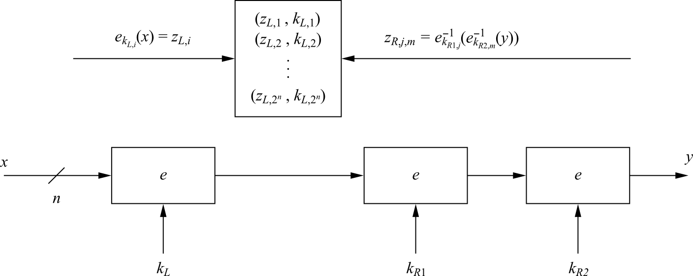
Triple Encryption
The encryption of a block three times y = e_{k3} (e_{k2} (e_{k1} (x)))
In practice a variant scheme is often used EDE (encryption-decryption-encryption)
y = e_{k3} (e⁻¹_{k2} (e_{k1} (x)))
Advantage: choosing k1=k2=k3 performs single DES encryption
Still we can perform a meet-in-the middle attack, and it reduces the effective key length of triple encryption from 3K to 2K!
The attacker must run 2¹¹² tests in the case of 3DES
Triple encryption effectively doubles the key length

Slide 47
Content of this Chapter
Encryption with Block Ciphers: Modes of Operation
Exhaustive Key Search Revisited
Increasing the Security of Block Ciphers
Double Encryption and Meet-in-the-Middle Attack
Triple Encryption
Key Whitening

Slide 48
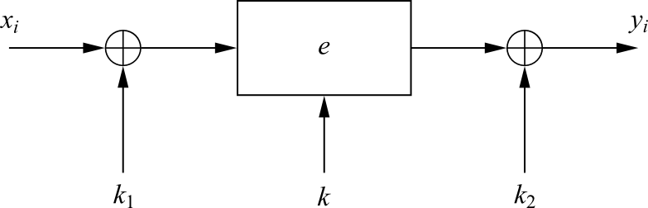
Key Whitening
Makes block ciphers such as DES much more resistant against brute-force attacks
In addition to the regular cipher key k, two whitening keys k₁ and k₂ are used to XOR-mask the plaintext and ciphertext
It does not strengthen block ciphers against most analytical attacks such as linear and differential cryptanalysis
It is not a “cure” for inherently weak ciphers
The additional computational load is negligible
Its main application is ciphers that are relatively strong against analytical attacks but possess too short a key space especially DES
a variant of DES which uses key whitening is called DESX

Slide 49
Lessons Learned
There are many different ways to encrypt with a block cipher. Each mode of operation has some advantages and disadvantages
Several modes turn a block cipher into a stream cipher
There are modes that perform encryption together together with authentication, i.e., a cryptographic checksum protects against message manipulation
The straightforward ECB mode has security weaknesses, independent of the underlying block cipher
The counter mode allows parallelization of encryption and is thus suited for high speed implementations
Double encryption with a given block cipher only marginally improves the resistance against brute-force attacks
Triple encryption with a given block cipher roughly doubles the key length
Triple DES (3DES) has an effective key length of 112 bits
Key whitening enlarges the DES key length without much computational overhead.

